Slide 1
AJAX

Slide 2
DHTML (Dynamic HTML)
• DHTML = JavaScript + DOM + CSS
• Used for creating interactive applications
• No asynchronous communication, however
> Full page refresh still required

Slide 3
Introduction
AJAX = Asynchronous JavaScript and XML
AJAX is not a new programming language, but a technique for creating better, faster, and more interactive web applications.
With AJAX, your JavaScript can communicate directly with the server, using the JavaScript XMLHttpRequest object. With this object, your JavaScript can trade data with a web server, without reloading the page.
AJAX uses asynchronous data transfer (HTTP requests) between the browser and the web server, allowing web pages to request small bits of information from the server instead of whole pages.
The AJAX technique makes Internet applications smaller, faster and more user-friendly.

Slide 4
About AJAX
AJAX is Based on Web Standards
AJAX is based on the following web standards:
JavaScript
XML
HTML
CSS
DOM
The web standards used in AJAX are well defined, and supported by all major browsers. AJAX applications are browser and platform independent.

Slide 5
DOM (Document Object Model)
Object Oriented Representation for XML and HTML documents
Based on Hierarchical (Tree) Structure
allows programs and scripts to build documents, navigate their structure, add, modify or delete elements and content
Provides a foundation for developing
querying, filtering,
transformation, rendering etc.
applications on top of DOM implementations

Slide 6
CSS (Cascading Style Sheets)
Set of Formatting rules that tell the browser how to present the document
Helps to separate the content from the presentation
Reduce the download time by removing the formatting information from the document
More control over formatting than HTML

Slide 7
So why is AJAX so hot—NOW?
Demand for richer applications is growing
  Broadband means we can—and want to—do more
Recent Google applications have sparked people’s imagination
  Google gmail, Google suggests, Google Maps
People are thinking of building APPLICATIONS…not just sites
The Tipping Point
  All of this has made rich internet apps reach its tipping point—where adoption spreads rapidly and dramatically

Slide 8
Real-Life Examples of AJAX apps
• Google maps
> http://maps.google.com/
• Goolgle Suggest
> http://www.google.com/webhp?complete=1&hl=en
• Gmail
> http://gmail.com/
• ZUGGEST- an XMLHttp Experiment using Amazon
> http://www.francisshanahan.com/zuggest.aspx

Slide 9
AJAX Basics
AJAX Uses HTTP Requests
With AJAX, your JavaScript communicates directly with the server, through the JavaScript XMLHttpRequest object
With an HTTP request, a web page can make a request to, and get a response from a web server - without reloading the page. The user will stay on the same page, and he or she will not notice that scripts request pages, or send data to a server in the background.

Slide 10
AJAX Basics
The XMLHttpRequest Object
By using the XMLHttpRequest object, a web developer can update a page with data from the server after the page has loaded!
AJAX was made popular in 2005 by Google (with Google Suggest).
Google Suggest is using the XMLHttpRequest object to create a very dynamic web interface: When you start typing in Google's search box, a JavaScript sends the letters off to a server and the server returns a list of suggestions.
The XMLHttpRequest object is supported in Internet Explorer 5.0+, Safari 1.2, Mozilla 1.0 / Firefox, Opera 8+, and Netscape 7.

Slide 11
A New Way of Building Applications
AJAX Applications Are:
3-tier client/server apps
  Browser ↔ App Server ↔ Data Source
Event driven
  User clicks, user drags, user changes data
Graphics Intensive
  Visual Effects, Rich Visual Controls
Are Data Oriented
  Users are manipulating and entering data
Are Complex
  Pages hold many more controls and data than page-oriented applications
  Multiple Master-Detail Relationships in one page

Slide 12
AJAX will change web development
AJAX represents a fundamental shift in how web applications are built
We’ll be building 3-Tier Client/Server applications with AJAX
Users want enhanced, interactive functionality
They want their data easily accessible and maintainable
They don’t want screen flicker
They don’t want over-the-top GUI—just functional
Once they see an AJAX application—they want it now

Slide 13
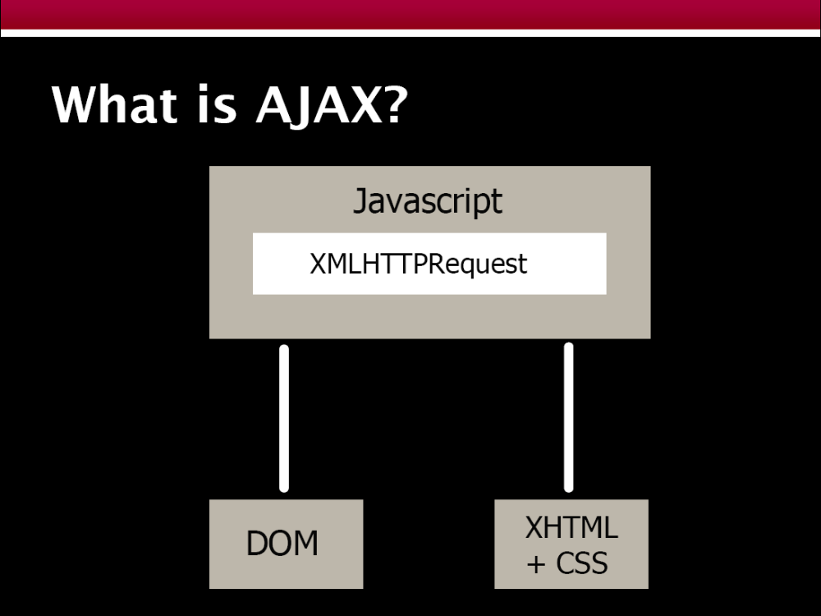

Slide 14
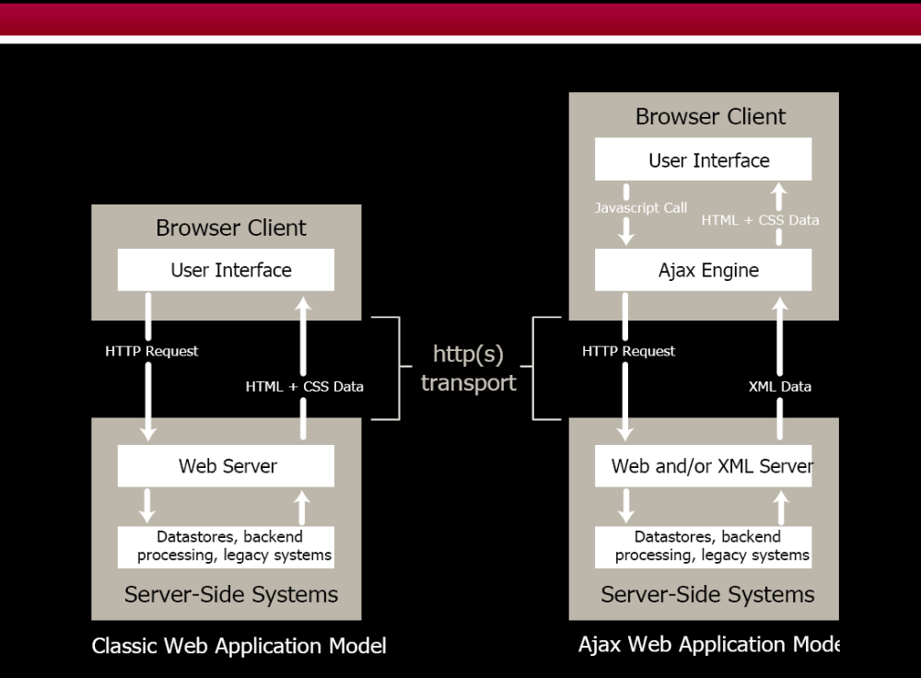

Slide 15
Two ways of talking to the server…
XMLHTTPRequest object
  Allows for asynchronous GETs + POSTs to the server
  Does not show the user anything—no status messages
  Can have multiple XMLHTTPRequest active at one time
  Allows you to specify a handler method for state changes
  Handler notified when request is:
    Initialized
    Started
    In the process of being returned
    Completely finished
  Originally only available for Microsoft IE

Slide 16
XMLHttpRequest Object: Methods
open(“method”, “URL”)
open(“method”, “URL”, async, username, password)
  Assigns destination URL, method, etc.
send(content)
  Sends request including postable string or DOM object data
abort()
  Terminates current request
getAllResponseHeaders()
  Returns headers (labels + values) as a string
getResponseHeader(“header”)
  Returns value of a given header
setRequestHeader(“label”,”value”)
  Sets Request Headers before sending

Slide 17
Security Issues
You can only hit the domain that the original web page came from
Because of this, the AJAX technique cannot normally be used to access a Web Service of a 3rd party server
  You can wrap those requests through your own server
  You can allow XMLHTTPRequest to access specific sites in your browser security settings
IFRAME can be used to access any site if needed

Slide 18
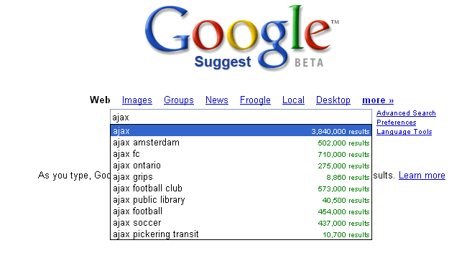
Wow..I didn’t
know soccer
teams did web programming..

